Slide 1
How to open a dataset
A simple guide on how to open a dataset

Slide 2
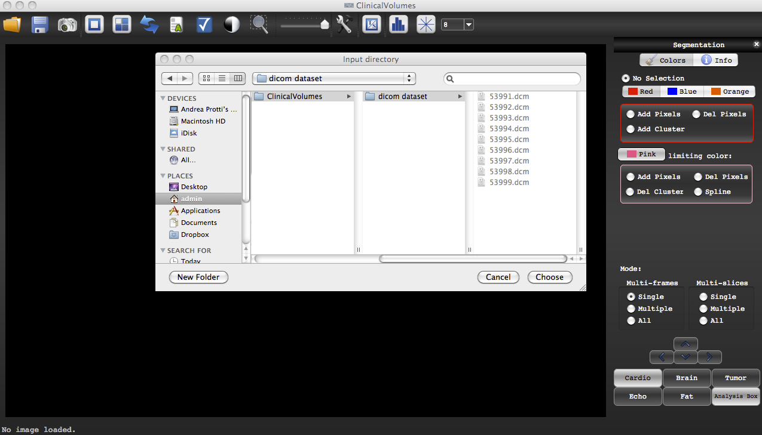
In order to open a dataset with ClinicalVolumes, the dataset must:
Be in DICOM format
Be in a folder or directory
Once using the command “Open DICOM Directory “, select the folder which contains the DICOM files and not the individual files !!! Select “Choose”
Open DICOM Directory
Select the folder containing the DICOM files
Press “Choose”

